Slide 1
NYC TAXI Data ANALYSIS
By: Ranon Sim

Slide 2
Analysis of new York taxi data
Objective
To predict the fare and tip amount of a taxi ride given taxi trip and fare data
Basic statistical measures and findings from analysis of dataset variables
Machine learning findings based on risk analysis
Expected outcomes and recommendations
Shortcomings
Understanding of metadata
Domain Knowledge

Slide 3
Data UNDERSTANDING
DEFINITION OF A TRIP
A record uniquely identified by the Taxi (Medallion), Taxi Driver (Hack_License) and Pickup Timing (pickup_datetime)
A record uniquely identified by a specific pickup location and dropoff location
System data
Taxi / driver data
Trip data
Fare data
Vendor_id, Store_and_fwd_flag, RateCode
Medallion (Taxi), Hack_license (Taxi Driver)
pickup_datetime, dropoff_datetime, Pickup_longitude, Pickup_latitude, Dropoff_longitude, Dropoff_latitude, Passenger_count, Trip_distance, Trip_time_in_secs
Fare_amount, Payment_type, surcharge, MTA_tax, Tip_amount, Tolls_amount, Total_amount

Slide 4
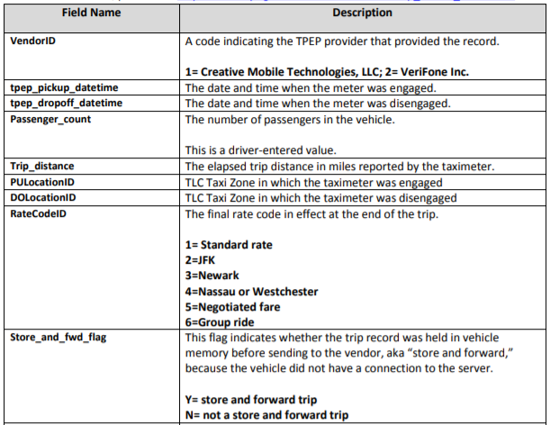
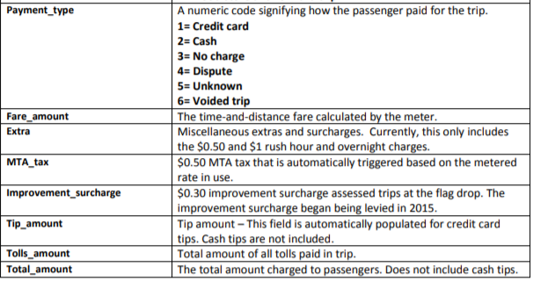
Data dictionary

Slide 5
DATA selection and preparation
DA
Merging of data
Trip Data
Raw Trip Data
Export as CSV
Trip Fare
Create backup
Removal of impossible data fields
Checking for duplicated records
Checking for Null Values
Rate codes >6
Longitude >180 or <-180
Latitude >90 or <-90
Trip duration <0sec and >2 hours
Trip distance <0 or > 50 miles
Fare amount < Base fair (2.50)
Initial Data Cleaning
Date Time Features
Fare Amount Features
Location Features
Feature Engineering
Day of Week / Day of Month / Hour
Fare per unit distance / Fare per second
Boroughs
Tip Predictive Dataset
Excludes Trips without Tips
Exploratory Data Analysis & Prediction
Subsetting of features
Dummification of variables
Filtering of missing/high cardinality values
Exploratory Dataset
Fare Predictive Dataset

Slide 6
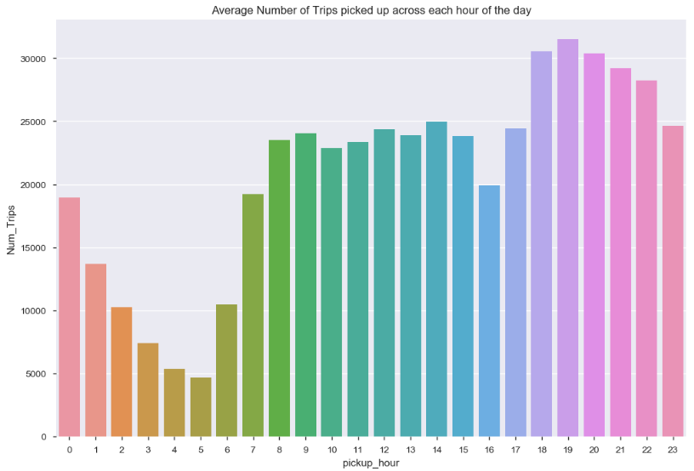
Basic Question: What are the top 5 busiest hours of the day?
6pm till 10 pm

Slide 7
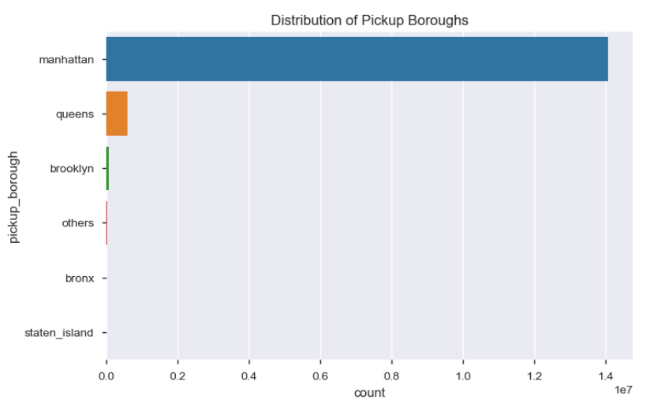
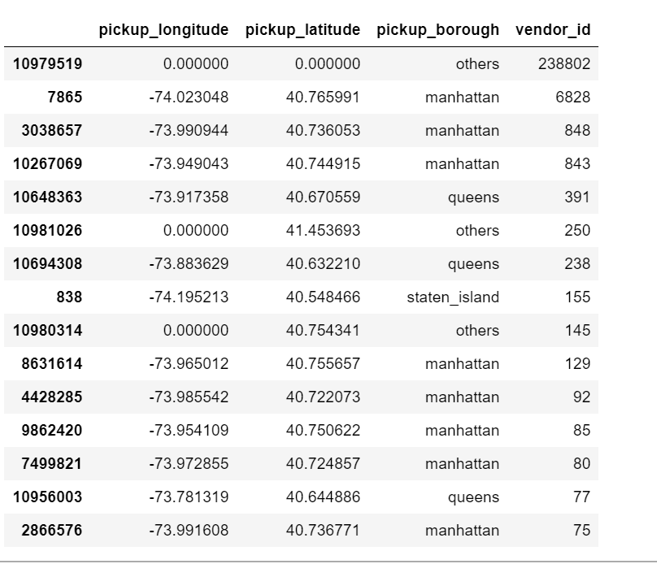
Basic Question: What are the top 10 busiest locations of the city?
Boroughs
Location by Pickup Lat/Long
#trips
Based on Borough, we see that manhatten is the most busy borough, followed by Others and Queens
The figure on the right shows the number of trip occurrences across specific locations (identified by pickup lat/long)

Slide 8
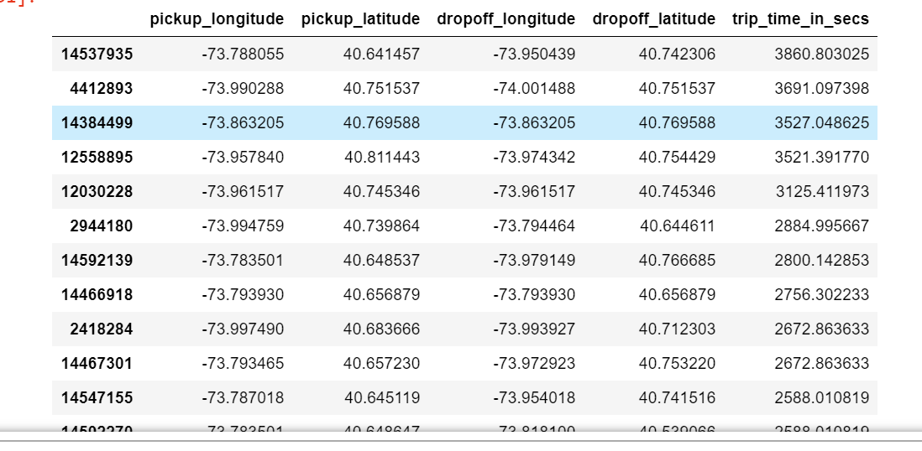
Basic Question: Which trip has the highest standard deviation of travel time?
Trip with highest S.D of travel Time
Standard Dev.

Slide 9
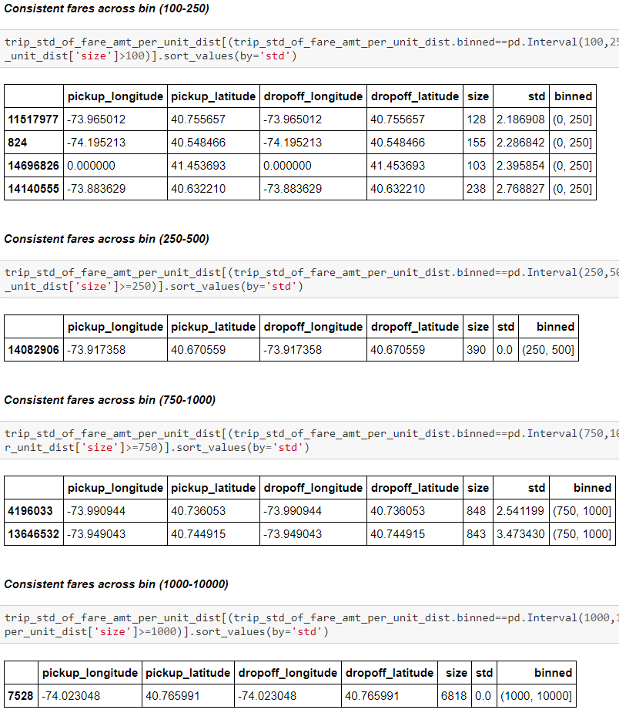
Basic Question: Which trip has most consistent fares?
Approach for the calculation of consistency
Calculate Fare Amount Per Unit Distance(miles in this case) : This is to ensure fairness in comparison btwn a short and long trip
Calculate the standard deviation of the fares in each trip
Group trips based on Count of Trips and bin it so that we can look at consistency across trips with diff #occurrences
Consistent

Slide 10
Approach to Building Models
Data cleaning and selection completed
Identify feature set to use as predictors + models
Build & Evaluate Models
Identify the evaluation criteria (RMSE)
Add more features
Tweak hyperparameters of model
Try more complex models
Add more data
Identify using
Correlation matrix
Feature Importance
Feature Selection techniques
Feature Engineering
Identify using
Grid Search Technique
LGBM etc.
Internal/External data
Create Naïve Baseline model (Average value of the target in the training data)

Slide 11
Model Building Phases
Iterative Improvement on models
Train a Basic Predictive Model for Fare /Tip Amount with Simple Features
Continue to tweak the Random Forest Regressor hyperparameters
Continue to tweak the Random Forest Regressor hyperparameters
Objective
Further tune RF
hyper-
parameters
Add New
Features
+
Check for
Collinearity
+
Use
Lasso
Regularization
for feature
selection
3 Features used
Models used:
Linear Regression
Decision Tree
Random Forest
3 Features used
Models used:
Random Forest
25 Features used
Models used:
Random Forest
Features/
Models
Random Forest Regressor model is the best model in the bunch.
Overfitting of model observed in the best model
Tweaking of hyperparameters reduces variance and improves RMSE of RF model
Time-related features are not linearly correlated with tip/fare amount
Adding of features greatly improve model performance
Conclusion

Slide 12
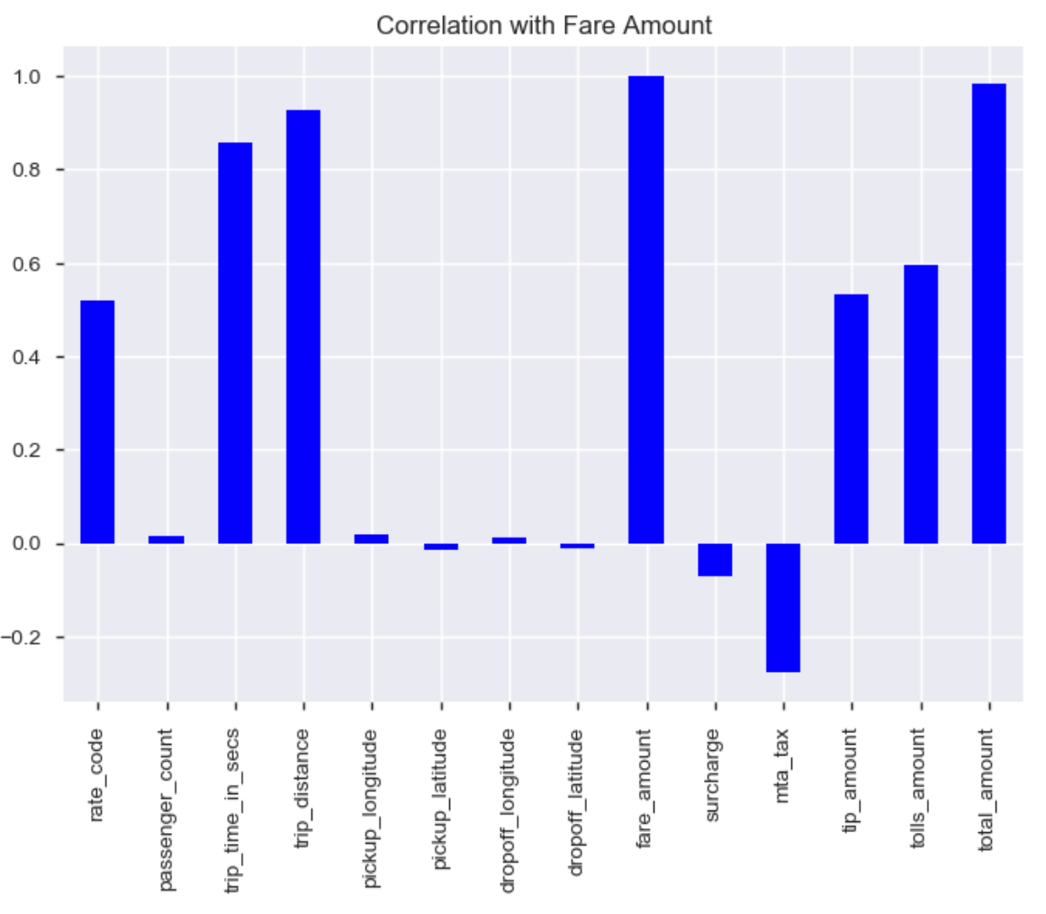
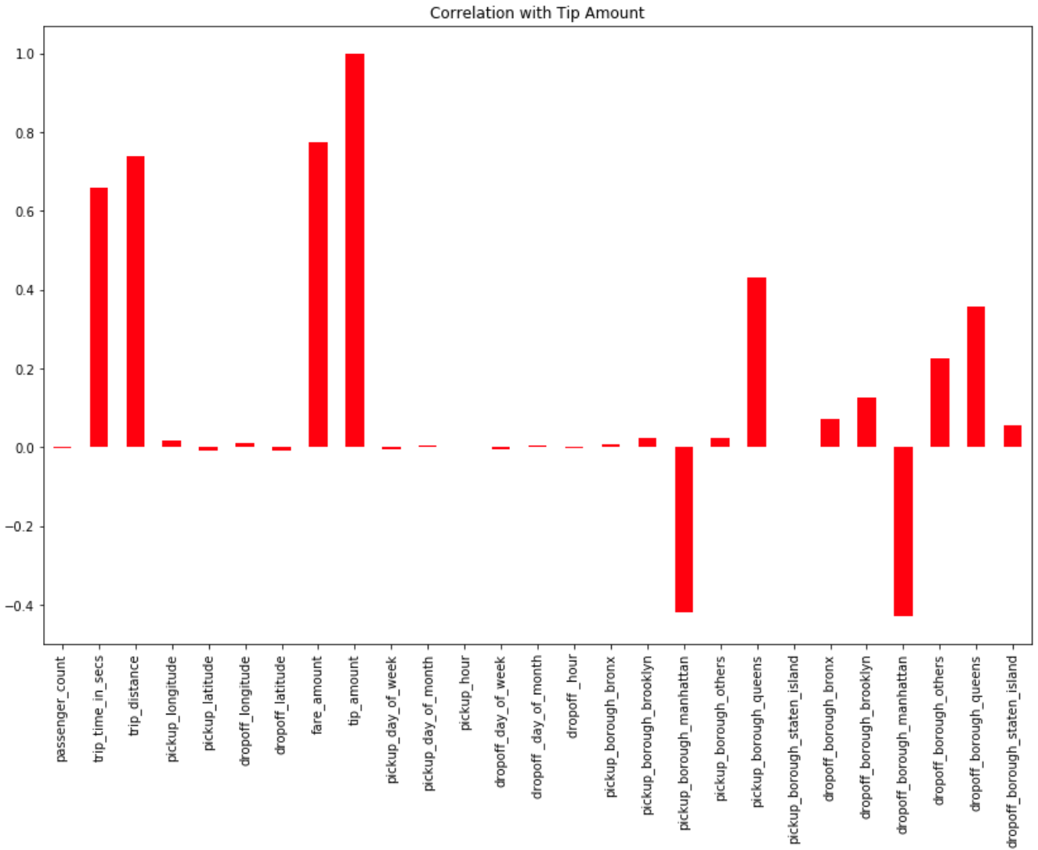
Weak linear correlation between time/location based variables and target could imply a non-linear relationship
This could also be why a non-linear model like Random Forest Regressor will perform better than a linear model (linear regressor)
Original features
Original + Time and Location features

Slide 13
Model Evaluation Results
Machine Learning Model Results
Fare Amount | Naïve Baseline Model | Linear Regression | Decision Tree Regressor | Random Forest Regressor
Round 1 (3 Features) | 16.28 (Test RMSE) | 7.03(Test RMSE) 7.02(Train RMSE) 0.14(Variance) | 5.72(Test RMSE) 2.09 (Train RMSE) 3.63 (Variance) | 4.66 (Test RMSE) 2.90 (Train RMSE) 1.76 (Variance)
Round 2 (Addition of 23 features including Location and Time) | 2.72 (Test RMSE) |  |  | 1.43 (Test RMSE) 1.13 (Train RMSE) 0.295(Variance)
Improvement in Test RMSE
In Round 1, Random Forest Regressor outperforms the other models when it comes to Test RMSE. However, the difference between Test and Train RMSE + Variance is high, indicating possible overfitting of results
In Round 2, Random Forest Regressor continues to improve when it comes to Test RMSE. Now, the difference between Test and Train RMSE appears to be closer and variance has further improved.

Slide 14
Improvements to model prediction
Predictive Models
Add more features
Tweak hyperparameters of model
Try more complex models
Add more data
Engineer more / better features
Grid / Random Search Technique
Try a more complex model
e.g. Gradient Boosted Machine or Deep Neural Networks
Get more data - either more observations or more variables

Slide 15
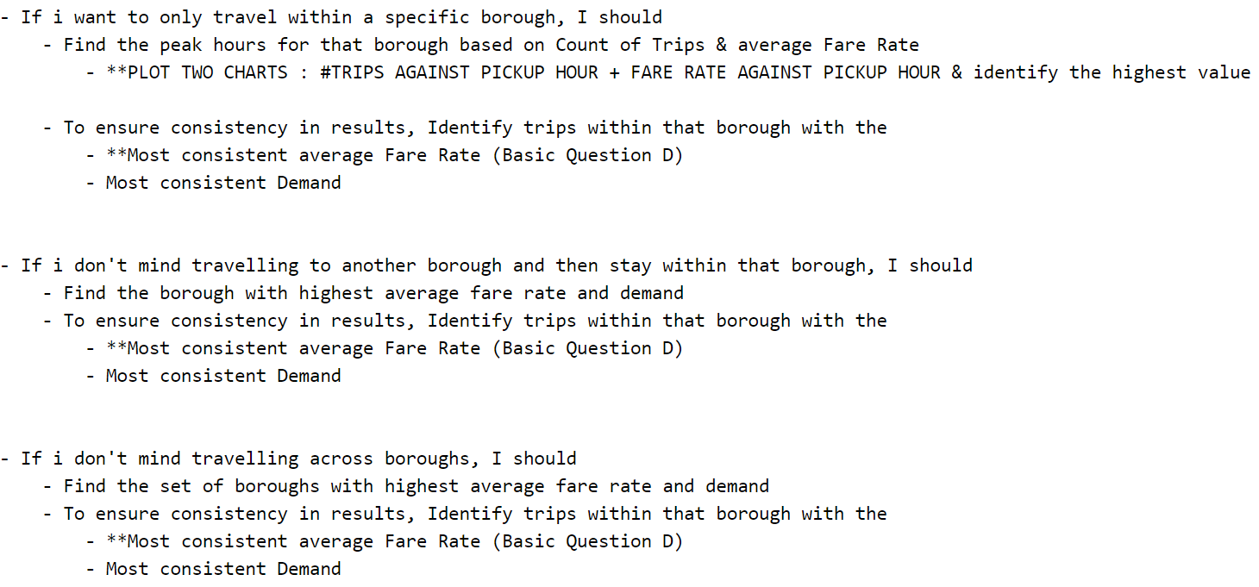
If you were a taxi driver, how would you maximize your earnings in a day?
STEP 1 - Identify approach
Try to find the day of the week, hours of the day and location (Borough) which provides
the highest average fare rate (Fare per unit distance / Fare per second)
the highest demand (Count of trips) or at least suff high demand to ensure there won't be a shortfall of passengers
To ensure consistency in results, identify those trips within the Step 1 Results that have the most consistent fares
STEP 2 – Strategize based on Taxi Driver Preference

Slide 16
If you were a taxi driver, how would you minimize your work time while retaining the average wages earned by a typical taxi in the dataset?¶
STEP 1 - Identify approach
Identify the average wage earned by a typical taxi driver
Remove outliers (1.5 IQR range) and take the average wage from the remaining taxi drivers
STEP 2 – Identifying Strategies
Strategy 1: Figure out how to minimize work time(earning the average wage in the least amount of hours) - Choosing the Shortest Trip (lowest trip duration) with the highest (fare + tip) per second - Identify the trips with the most consistent (fare + tip) per unit distance (Basic Question D but take the rate) - Select within one borough if possible (Try to optimize for this but also cater to diff taxi driver preferences)
Strategy 2: Defining qn as an optimization problem - Define cost function for minimizing work time - Identifying different solutions (Google Search)

